Slide 1
The Pennsylvania Horticultural Society motivates people to improve the quality of life and create a sense of community through horticulture.
Notes:
Thank you for attending this webinar/training.
This is the second of six training modules, presented through grant funding from EPA Region III, in order to help clarify appropriate maintenance techniques for Green Stormwater Infrastructure practices (GSI). It is our hope that the information included here will be helpful for anyone who is learning about GSIs or is training others about properly maintaining the practices.

Slide 2
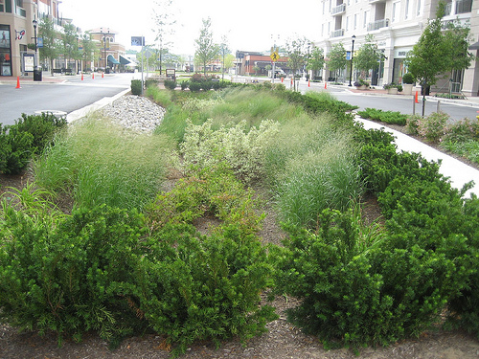
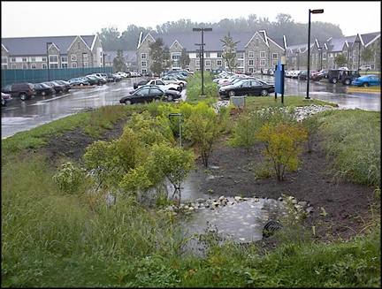
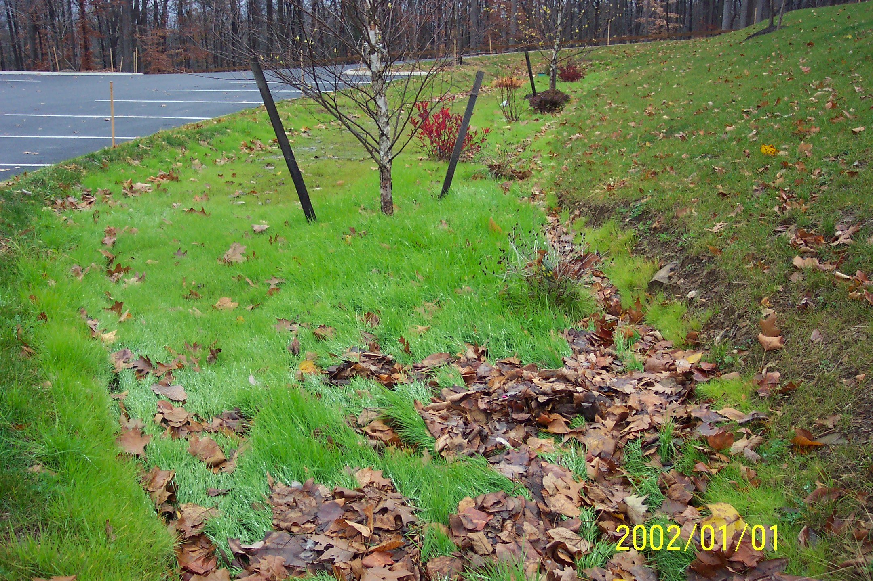
Maintaining Green Stormwater Infrastructure (GSI) Systems
Sustaining green infrastructure through proper landscape management
Components of the Bio-retention Systems
Emma Melvin
PHS Regional Project Manager
Notes:
The materials in the training sessions include the following:
*A glossary of terms used in describing and discussing GSI practices (also referred to as “systems”)
*A checklist of activities to be considered when evaluating the condition of the BMPs.
Fundamental to each training module is an explanation of the design of the systems and pertinent information for maintaining them.
Introduce project
Explain the glossary of termsExplain layout of the trainings
Go through the training outline background, explanation of design & maintaining systems

Slide 3
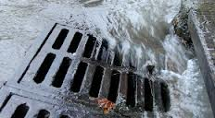
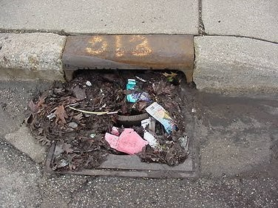
Grey Stormwater Infrastructure
Stormwater Drains
Notes:
What connects development to streams? In highly developed areas we currently strive to drain water off our built environment as quickly as possible. To do this we have changed the slope of the land, increased paved areas and designed our buildings, roads and sidewalks to move water quickly and efficiently away, into a conveyance system. There are usually two types of conveyance systems: an open system made up of swales; and a closed system, also called grey stormwater infrastructure, made up of storm drains, culverts and outfalls that are connected directly to a local water body.
How does this change the management of water in a watershed? These conveyance systems increase the volume of water and the speed at which the stormwater gets into the stream. Fast-moving water has more force and will more quickly erode stream beds and banks. Large quantities of water have the capacity to pick up and hold more sediment, which is carried downstream and eventually deposited as silt. In an undisturbed area such as a forest, stream levels slowly rise and fall during a rain event. In a built environment, the water level rises quickly to extremely high levels and then falls quickly. Bugs and animals can not adjust to the rise and fall of the water level, and their homes are destroyed during these events. Over time these streams lose most of the bugs and animals that once lived there.
Components of grey infrastructure.

Slide 4
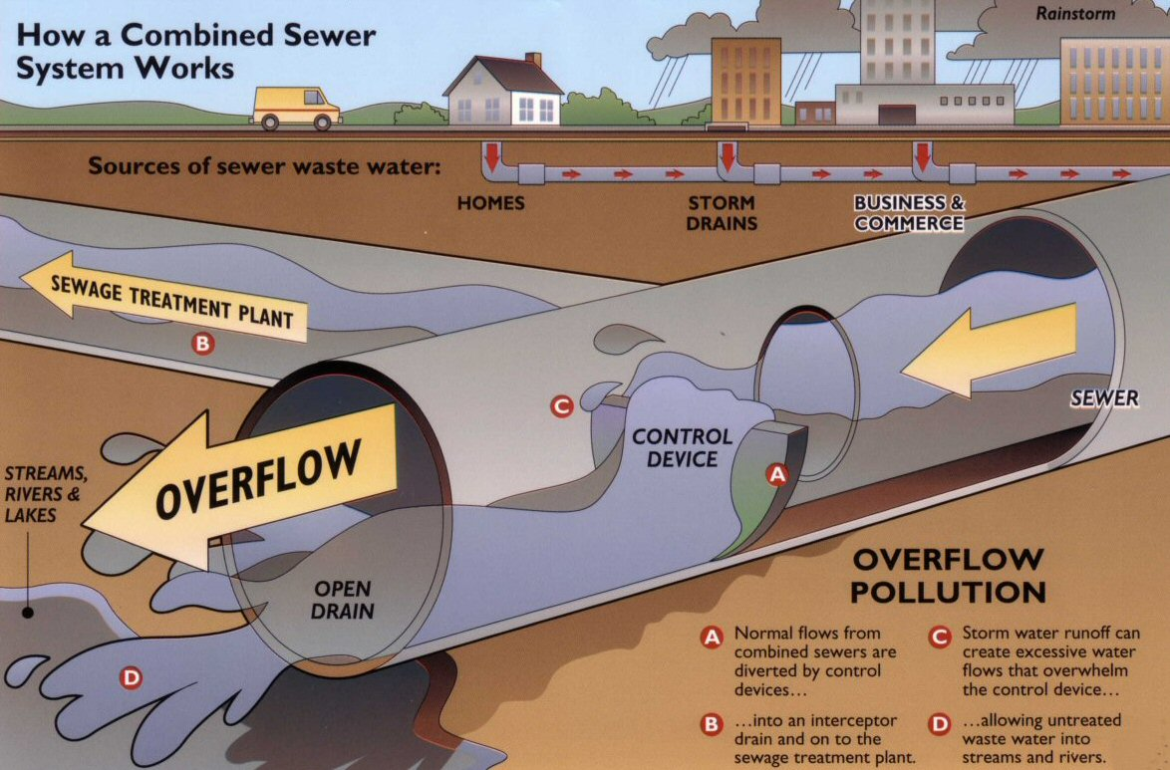
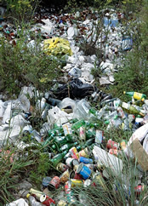
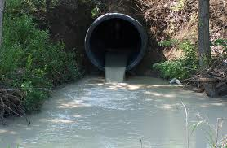
Grey Stormwater Infrastructure
Culvert pipes, outlets and combined sewer overflows
Notes:
How is water treated in grey infrastructure? These systems are designed to drain quickly, from one grey infrastructure component to the next. The components may consist of: storm drains; pipes; culverts; swales and outfalls. After entering the storm drains (carrying water, trash, debris and pollutants) the water enters into a system of pipes and culverts under our roads. These pipes typically drain directly into our streams through outfalls or swales.
What is a combined sewer system and what happens when it overflows? In older systems the stormwater infrastructure may be combined with sewage water infrastructure. The pipes carrying sewage also will carry stormwater during rain events. During dry weather, the sewage is diverted to the wastewater treatment plant. But during a rain event, the water level exceeds that which the pipes can divert and the additional water (sewage and stormwater) overflows directly into the stream (labeled a combined sewer overflow or CSO). We call these systems combined sewer systems.
Cities all across the USA have been required to reduce or eliminate these overflows by one of two methods:
By storing stormwater and slowly releasing the water into the system; or
By reducing the stormwater that enters into the sewer system by infiltrating the it into the ground.
The City of Philadelphia has turned to green stormwater infrastructure to manage their stormwater by promoting infiltration.

Slide 5
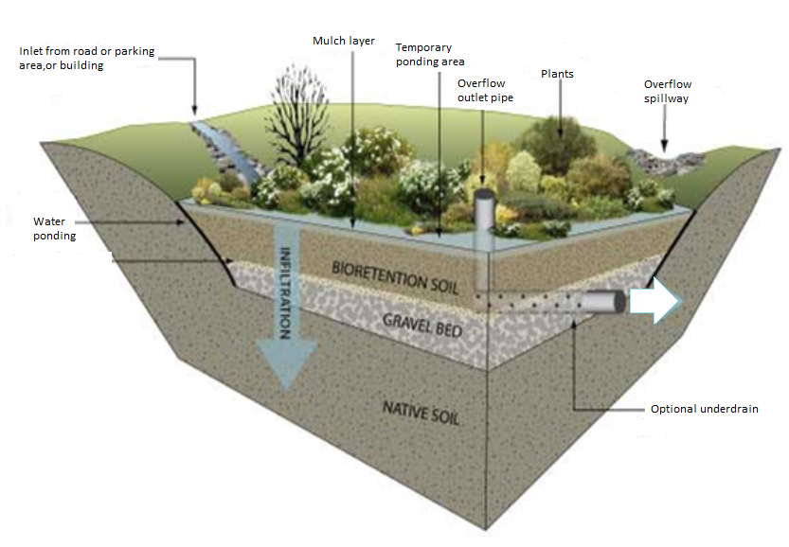
Bio-retention cross-section
Notes:
Bio-retention systems are commonly called rain gardens- which is used to describe the most common form of bio-retention with one or multiple recessed planting beds that receive stormwater. Other practices include bio-swales, swales densely planted, with a series of berms or check dams that hold and slowly move water through the swale to absorb and treat stormwater. Tree Trenches are also another form of bio-retention systems, using trees as the main vegetation, with a sandy soil trench extending from one tree pit to the next, gravel storage underneath with limited ponding at the surface of the tree pit.
This is a drawing of a bio-retention system. All systems have 3 main parts.
Components of the system-
inlet/entrance- where water enters the system. Can include any combination of pipes, swale, forebay or stormdrains, curb cut or sheet flow in.
Planting bed- a recessed planting area that detains water, allows materials in the water to settle out and water to absorb into the ground. Will include porous soil (the powerhouse of the system), mulch (the first line of defense) and plants. Many include underdrains beneath the soil medium drain excess water through the underground pipes.
Outlet/exit- where the water leaves the system after the water reached the designed ponding depth. There are typically two outlets: an in-bed outlet made up of riser pipe and cover and an overflow which is a depressed area in the berm/top edge of the system that directs water out of the system to a designated area.

Slide 6
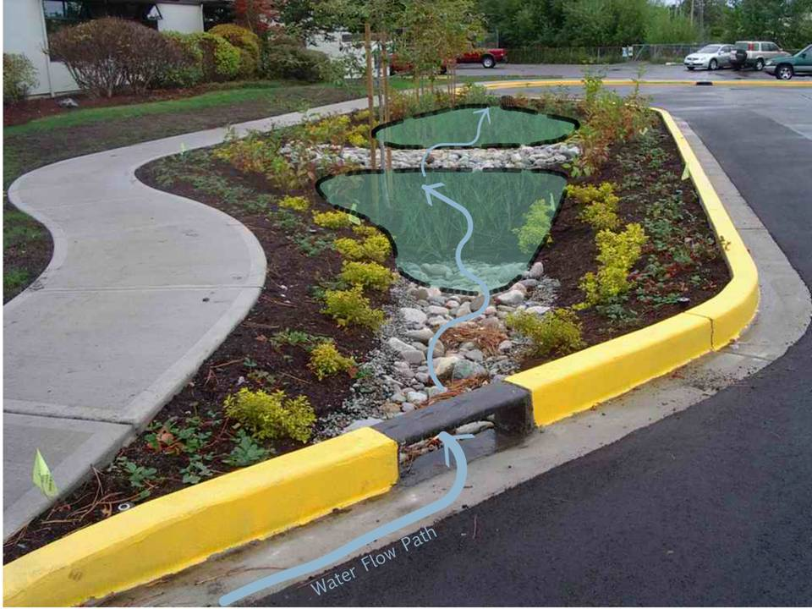
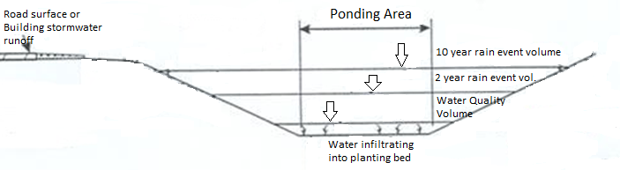
Bio-retention
Cross-section
Notes:
This is how water moves through the system. The bio-retention system are sized for a certain amount of water to move in the system, pond, drain and excess water moves out of system when full. Inlets designed to allow water in are reinforced to reduce erosion caused flowing water. The ponding areas can have a check dam to slow water movement through the system. If system has two ponding areas, different maintenance issue will be present in the two ponding areas. The first ponding are will have more sediment deposition and may have slower drainage. The second ponding area may have more vigerous growth, a little more trash and weeds.

Slide 7
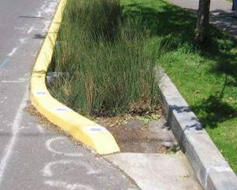
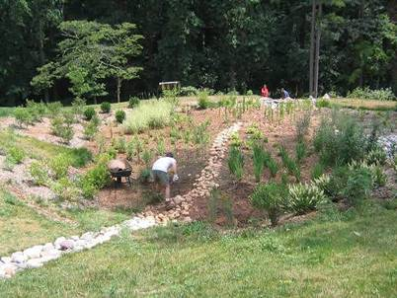
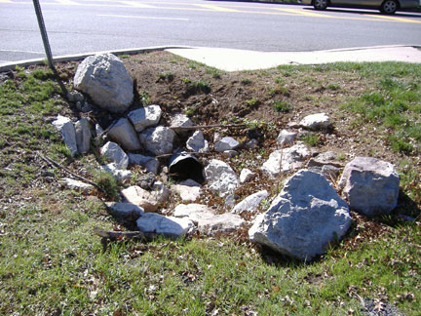
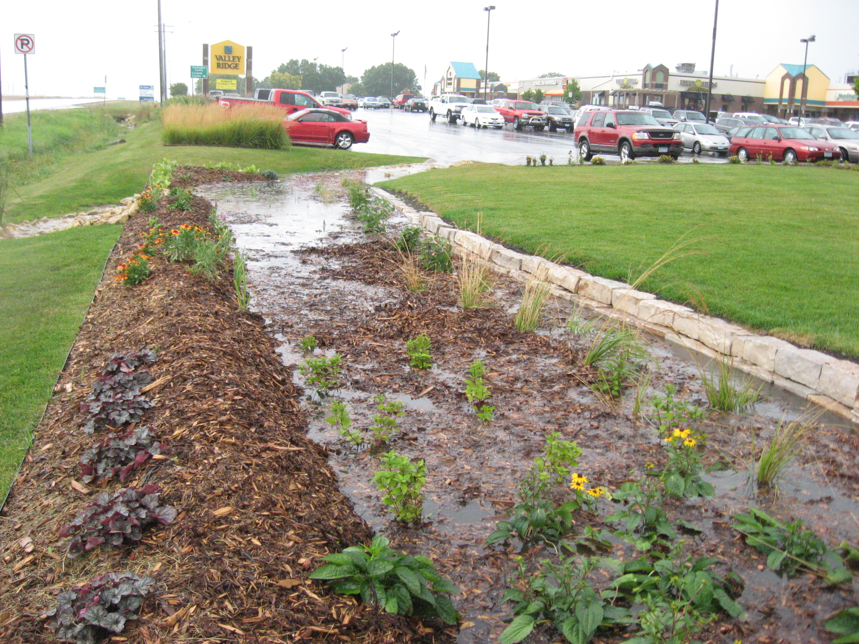
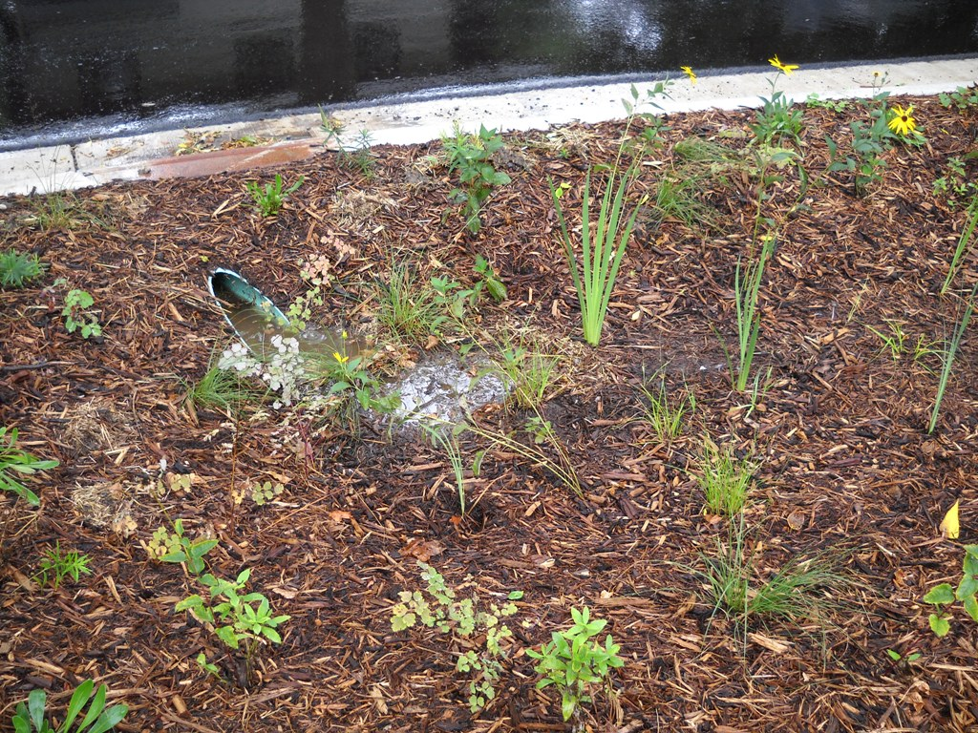
Inlets
Notes:
These are a series of inlets that may be present in a bio-retention system, including pipes, culverts grass lined swales, and rock lined swales.

Slide 8
Inlet maintenance
Pipes & Closed inlets
    Clogging
      Sediment
      Leaf litter
      Trash
    Issues
      Water bypass the inlet (from clogging or too
      much flow)
      Erosion at the outlet of the pipe
Open swales
    Erosion
      Gully formation
      Additional sediment carried into planting bed
      Plant dieback
Notes:
Each component of the system will have unique maintenance issues. When maintaining a site, always check the inlets and outlets before you start work within the planting bed. Ensure that water is able to enter the bio-retention system unobstructed. If this occurs water will bypass the system and can cause erosion at the inlet and if there is limited flow space in the pipes it will cause erosion at the exit of the inlet. When you have an open swale either soft surface-vegetated or hard surface such as a paved or rock lined erosion can occur if the water is entering to quickly or if part of the entrance is clogged. Either of these situations can cause gullying or plant die-back in a soft surface swale and can cause gullying and plant die-back in the planting bed in a hard surface swale.

Slide 9
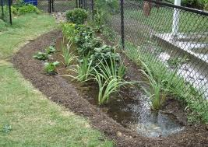
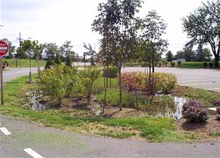
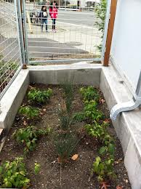
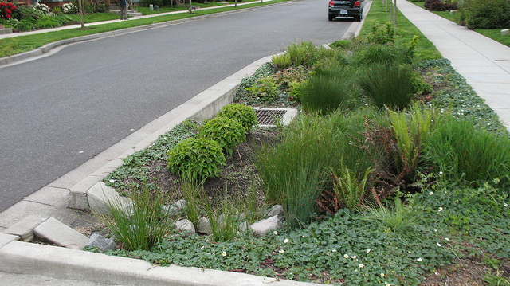
Planting bed or ponding area
Notes:
Water can enter the planting bed in many ways and can create different maintenance issues. These are examples of different planting bed

Slide 10
Planting Bed maintenance
Issues
      Soil compaction
      Soil saturation
      Sedimentation
      Leaf litter
      Trash
      Erosion at inlet and outlet pipe outfall
      Gully formation
      Changes in the contour of the bed
      Plant dieback
      Unwanted plants- weeds
Notes:
Before entering the system to do maintenance on the planting bed ensure that the soils are dry. Working within a planting bed still wet from a rain event can lead to soil compaction this will lead to additional issues later on including soil saturation, limited infiltration and plant die back.
Assess the condition of the planting bed before entering the system, issues you will look for include soil compaction, soil saturation, sedimentation, excessive leaf litter and trash, erosion throughout the bed, gully formation, changes in the contour of the bed from a flat level surface to a sloped surface. Also assess the plant community, ensure that the originally planted species are alive and healthy and that weeds or other unwanted plants have not over run the planting bed.

Slide 11
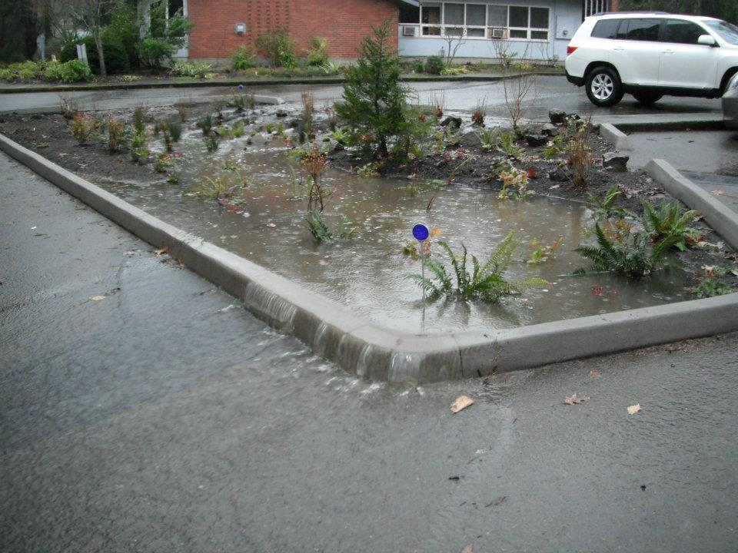
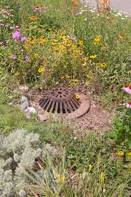
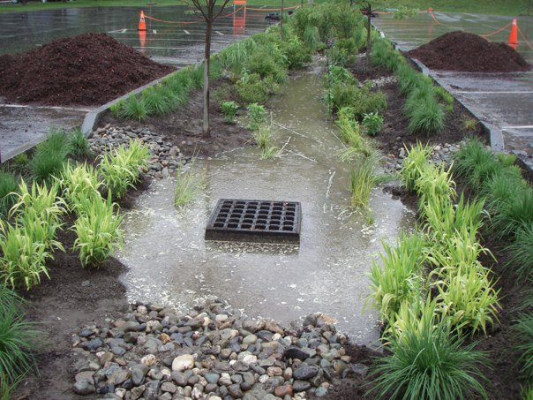
Overflow or Outlet
Notes:
Bio-retention systems are designed to hold and retain a certain volume of water. Excess water will be directed out of the system through the outlet. The outlet of the system can be located inside the planting bed with a dome riser grate. But make sure you have identified all possible outlets, including ones inside the planting beds and other outlets including any recessed area in the edges of the planting bed that will allow for overflow for larger events.

Slide 12
Outlet maintenance
Pipes & Closed outlets
    Clogging
      Sediment
      Leaf litter
      Trash
    Issues
      Water unable to exit system
      Erosion at the outlet of the pipe
Overflow
    Erosion
      Gully formation
      Mulch carried out of garden
      Plant dieback
Notes:
Maintenance issues that can arise with outlets include the same issues are the inlets. They can become clogged with sediment, leaf litter and trash. Water can get stuck inside the system causing soil saturation in the planting bed. Clogging can also lead to erosion around the outlet structure. Both of these situation can lead to plant die back. During all storms mulch can be moved around the planting bed, in large storms mulch can be carried out of the planting bed.

Slide 13
Next up……………….
Spring and Summer maintenance
Notes:
This completes our overview of components of a bio-retention system, our next session will be on Spring and Summer maintenace.

Slide 14
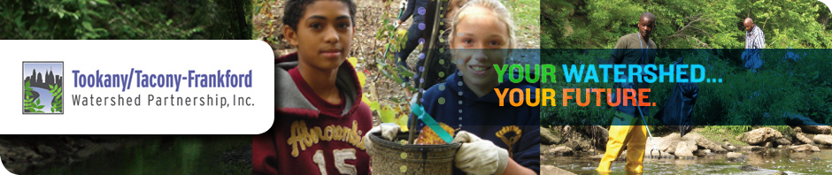




THANK YOU TO OUR
FUNDER & PARTNERS

